Slide 1
EXPLORATORY
DATA ANALYSIS
PADMINI MANOHARAN

Slide 2
Objective
To do exploratory data analysis on YouTube data.

Slide 3
Overview
Channels
2,121
Videos
5,248
Categories
16

Slide 4
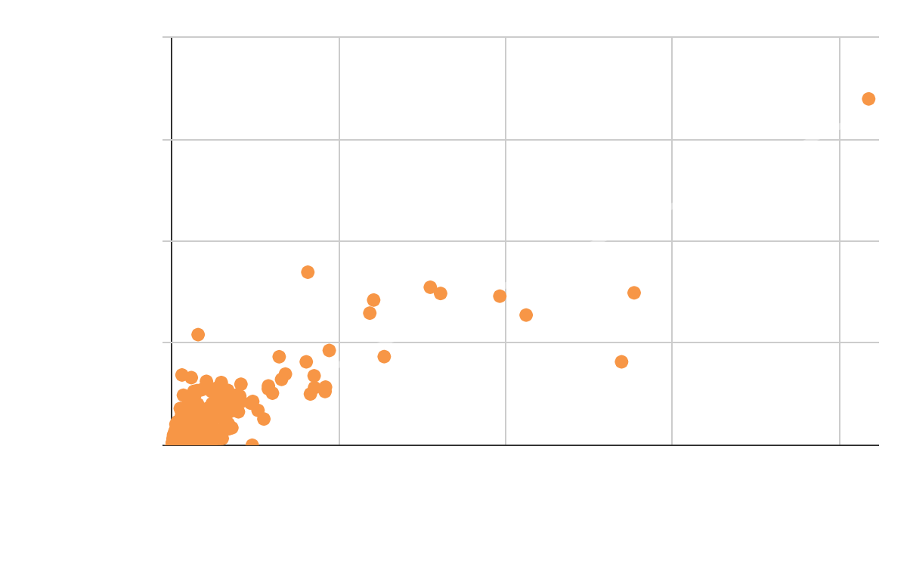
Likes Vs Views
Views are affected by the Likes
Likes and Views are positively correlated

Slide 5
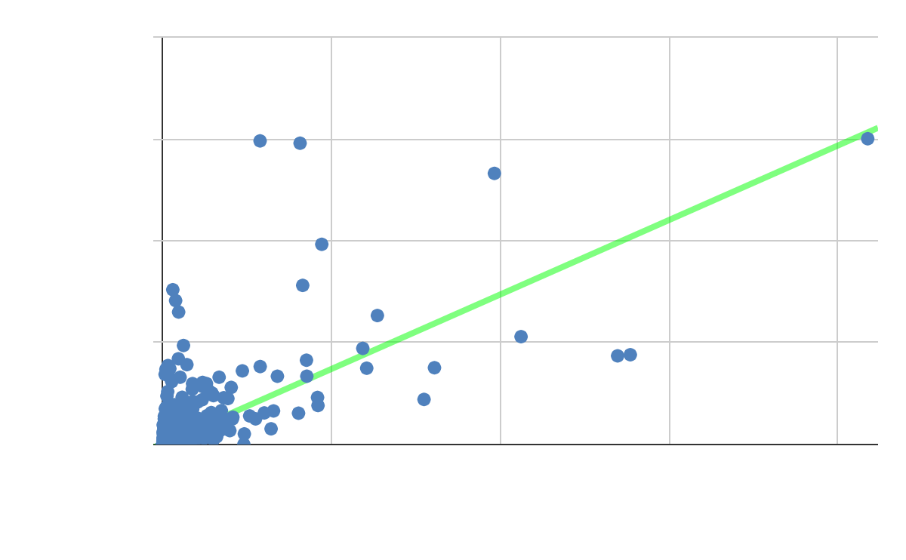
Dislikes Vs Views
Views are not affected by the Dislikes
There is no correlation between Views and Dislikes

Slide 6
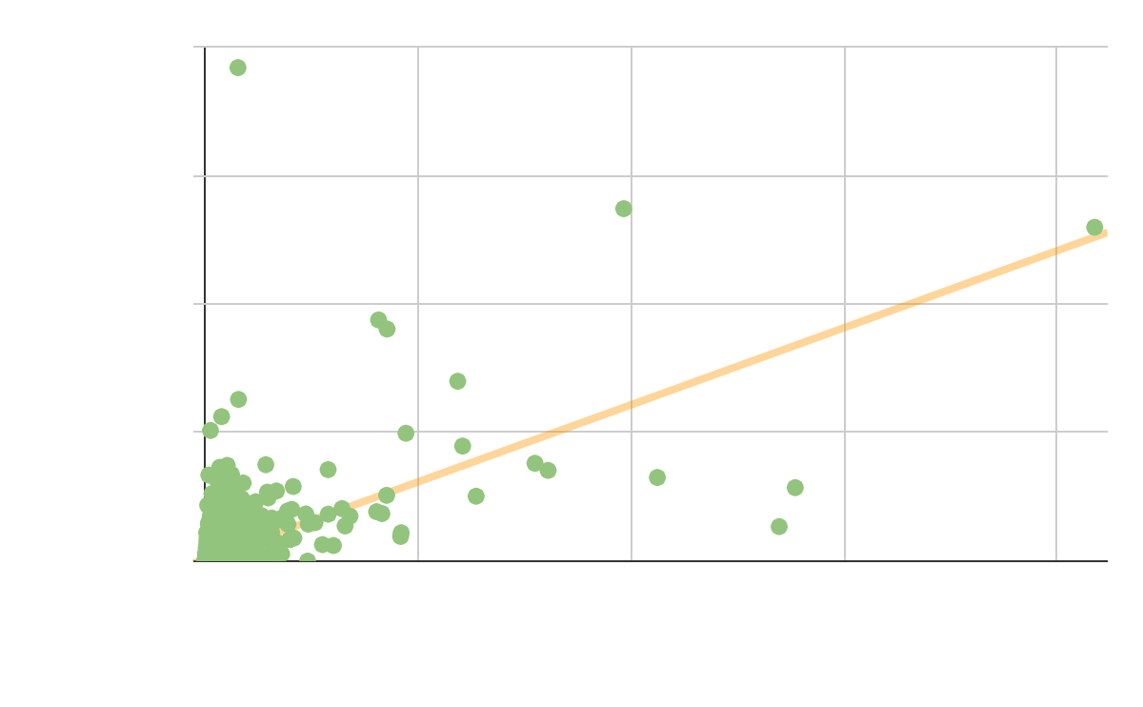
Comments Vs Views
Views are not affected by the Comments
There is no correlation between Views and Comments

Slide 7
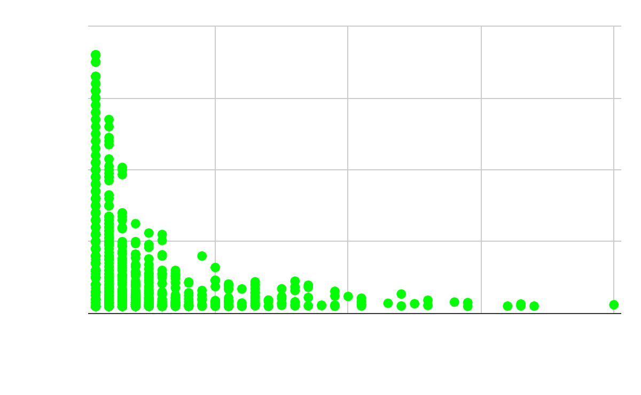
Channel Level Analysis
Trending duration decreases, as the frequency of upload increases.
Channels uploading frequency resulting in lower trending periods.

Slide 8
Appendix
Exploratory Data Analysis
Correlation Analysis between Views and (Likes, Dislikes, Comment Count)
Correlation between Upload Frequency and Trend Duration

